Slide 1

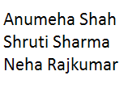
Cloud Computing in Social Networks

Slide 2
Introduction
Social networks provide a platform to facilitate communication and sharing between users.
Social network platforms have rapidly changed the way that people communicate and interact.
Platforms like Twitter, Facebook, Google+ and LinkedIn enable the participation of people in digital communities.
Some communities even exceed the population of large countries, for example Facebook has over 400 million active users.

Slide 3

Why use a Social Cloud?
With the increase in social networking sites, a large increase of content sharing is observed in social networks.
Cloud computing allows the distribution of services such as storage and processing.
Social cloud is the blend of both cloud computing and social networks.
Social networks offer some limitations.
Fig from wikipedia.org/wiki/social_cloud
For example, if a user needs to view a Flash video uploaded in a social network such as Facebook. The user should have the Flash player installed in his machine.
Using social cloud, users can share contents by taking the advantages of cloud in terms of storage.
In a social cloud the resources are no longer offered by anonymous providers but rather by socially connected users.

Slide 4
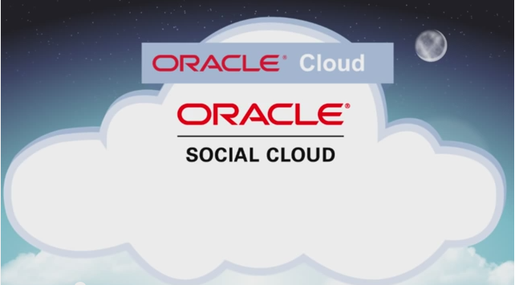
What is a Social Cloud?
Social cloud is defined as “a resource and service sharing framework utilizing relationships established between members of a social network” as cited in Gayathri K.S, J.Jaysudha, Tony Thomas “Security Issues of Media Sharing in Social Cloud”.
Fig from wikipedia.org/
wiki/social_cloud

Slide 5
Issues in Social Cloud Systems
Free-riding behavior of users.
IEEE focus paper : “Incentive Provision and Job Allocation in Social Cloud Systems”.
Traversing NAT
Handling of non static IP addresses and multiple operating systems
Security
IEEE focus paper : “A Social Compute Cloud: Allocating and Sharing Infrastructure Resource via Social Networks ”.
Implementation of Geo distributed cloud and the challenges of how to store and migrate the contents cost effectively and efficiently.
IEEE focus paper : “Scaling Social Media Applications into Geo Distributed Clouds”

Slide 6

“Incentive Provision and Job Allocation in Social Cloud Systems”
IEEE Journal on Selected Areas in Communications/Supplement, Volume:31 , Issue :9 , September 2013.
Yu Zhang, Student Member, IEEE
Mihaela van der Schaar, Fellow, IEEE

Slide 7
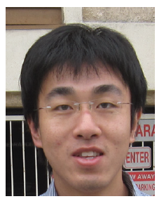

Authors
Yu Zhang
Received the bachelor’s and master’s degrees from Tsinghua University, Beijing, China. He is currently working towards the Ph.D degree with the Department of Electrical Engineering, University of California, Los Angeles.
Mihaela van der Schaar
Received the Ph.D degree from Eindhoven University of Technology, the Netherlands, in 2001. She is now a Professor with the Electrical Engineering Department, UCLA.

Slide 8
Setup
Social Clouds provides a resource sharing mechanism where participants share resources on the basis of the relationships in a social network.
Resources includes storage space, bandwidth ,CPU cycles.
The performance depend on the users’ cooperative behavior in sharing their computing capabilities.
Social cloud system consists of users and cloud operators.
Users can be buyers or supplier’s. Supplier can also be a buyer.
Cloud operators are the designers and operators of the system.

Slide 9
Cloud operators are responsible for designing and implementing
The pricing scheme and the payment infrastructure
The incentive mechanism to regulate the behavior of suppliers
The job allocation scheme which schedules the load (the amount of resources purchased) of incoming tasks among suppliers.
It is assumed to have a single cloud operator in the system.
Buyer submits task, regarding resources needed, together with the payment to the cloud operator.
Cloud operator identifies the suppliers and divides the task amongst them.
After receiving the payments the suppliers provide their resources to the buyers.

Slide 10

Issues
Need to motivate users to share resources.
Need to prevent free-riding behavior of users.
If payment is given in advance, a supplier always has the chance to take the payment without providing the promised resources.
If payment is after the task is performed, the buyer can refrain from paying to the suppliers.

Slide 11
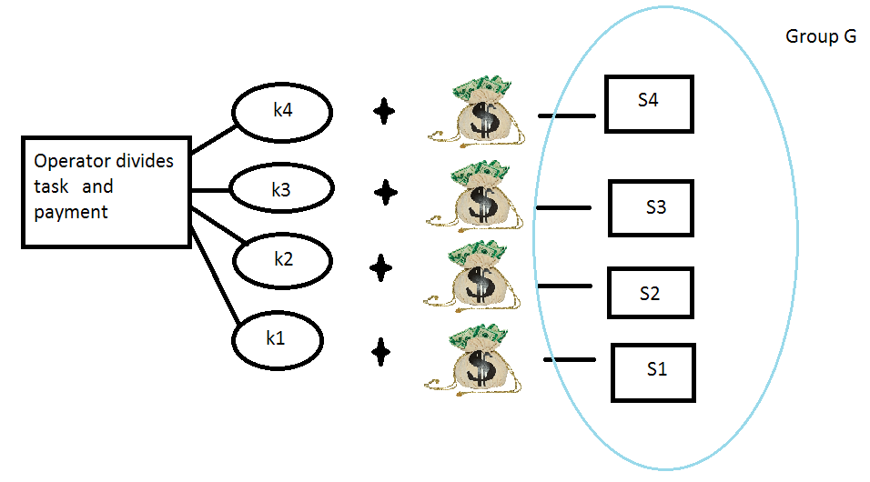
Proposed Solution
A buyer needs some resources and submits a task to the operator.
The load of a task, denoted as K ∈ R+
R+ represents the total amount of resources needed to fulfill this task.
Operator selects a group of suppliers, who have sufficient idle resources.
Operator determines the total price that the buyer has to pay.
Let G denote the group with each supplier indexed
with i ∈ {1, . . . , |G|},
the operator divides the
load as |G|, {ki}
i=1 where ki is the load
of the job assigned to the
i-th supplier.

Slide 12
Incentive Mechanism
Assign a reputation to each supplier in a social cloud system.
The reputation is represented by a θ which is a natural number
from the finite set , {0, 1, . . ., L}, where L is called the reputation length.
A supplier earns its reputation based on its past resource provision behavior.
Cloud operator assigns higher payments to suppliers with higher reputations.
Suppliers are provided incentives to contribute their resources.
Define the reputation scheme τ,
Shows how the reputation of each supplier should be updated.
τ is updated by feedback report r ∈ {0, 1}, from buyer.
If positive report r = 1 else r=0.
So if r=1, then reputation of each supplier is increased by 1 with a probability α.
If r=0, then reputation of each supplier falls to 0 by a probability β.

Slide 13
Pricing scheme
The pricing scheme can be expressed as ψ(θ) and provides rewards/punishments to suppliers according to their reputations.
With ψ(θ) increasing on θ the incentive to free-ride is suppressed since a supplier is encouraged to provide resources in order to build up its reputation.
Job allocation scheme
Denotes how to divide the task into jobs equally and allocate to suppliers.
The operator divides task of a load K into ϕ(K) jobs.
Each job has a load K/ϕ(K).
After the task division, the operator randomly selects ϕ(K) suppliers, each of whom having at least an amount K/ϕ(K) of idle resources
Then the operator assigns one job to each of the suppliers.

Slide 14
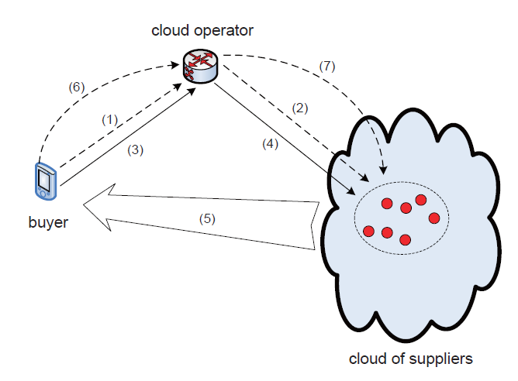
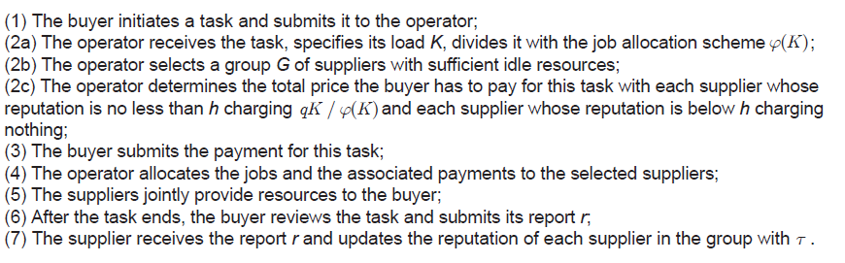
Figure from Yu Zhang,Mihaela van der Schaar, “Incentive Provision and Job Allocation in Social CloudSystems”

Slide 15
Design Variables
The design variables available to the operator is a tuple π = (L, h, α, β, ϕ), which is referred to as a social cloud protocol (SCP).
The first four elements of an SCP represent the incentive mechanism,
Where L determines the length of the history recording a supplier’s past behavior
h represents the cutoff threshold in the pricing scheme, supplier receives a payment when the reputation is high.
α is the forgiving probability
β is the punishment probability.
The last element ϕ represents the job allocation scheme.

Slide 16
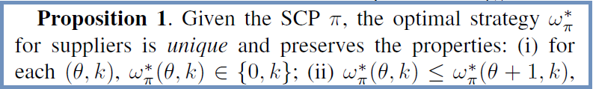
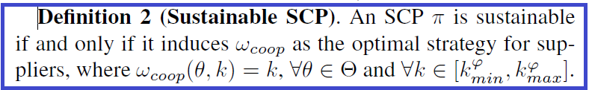
Definition 1 (Optimal Strategy)
Optimal strategy ω∗.
k is load, θ is reputation.
There are two important observations from Proposition 1.
First, at any reputation θ, a supplier’s action choice in one job is always binary.
Second, a supplier’s behavior to free-ride decreases with its reputation.
Design an SCP under which no supplier finds it in its self-interest to free-ride.

Slide 17
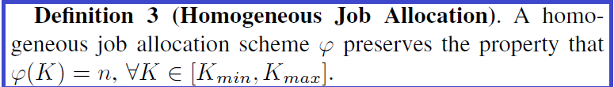
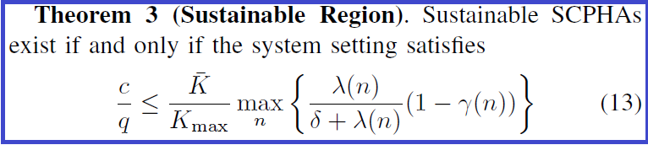
Task is always divided and assigned to a constant number of suppliers regardless of its load.
An SCP with homogeneous job allocation is called SCPHA.
For instance, when the unit cost c is large the operator should select a larger price q( payment received from buyer) in order to attract suppliers to contribute resources without free-riding.
Smaller Kmax should be selected which indicates that the system cannot accept tasks with too large loads in order to prevent free-riding.
λ(n) is the arrival rate of tasks at each supplier.
γ(n) is the failure probability of each task.

Slide 18
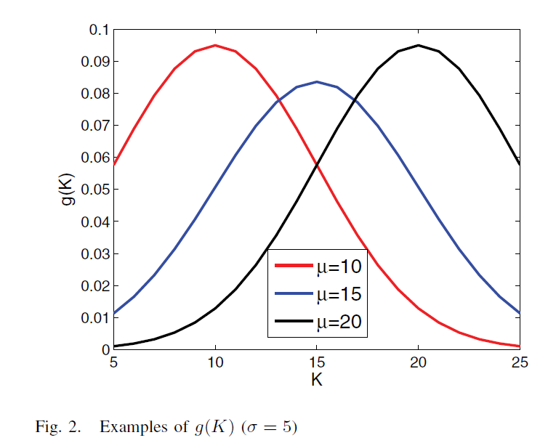
Experiments
g(K) is the distribution
of the load of the incoming
tasks.
K is the load.
Figure from Yu Zhang,Mihaela van der Schaar, “Incentive Provision and Job Allocation in Social CloudSystems”

Slide 19
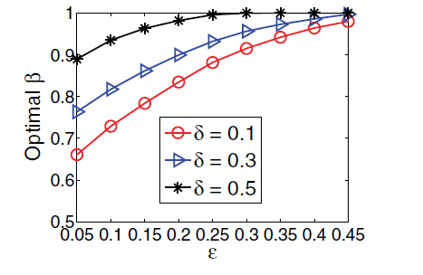
Optimal Incentive Mechanism
Error probability means the probability that caching and retrieving latencies, processing delays, networking errors occurs.
β punishment probability.
A supplier’s incentive to cooperate decreases when the error probability increases. Hence, β increases to
provide sufficient punishment.
The discount factor δ increases.
When a supplier becomes more
interested in the instant gain from
the current job, larger punishment
needs to be enforced.
Figure from Yu Zhang,Mihaela van der Schaar, “Incentive Provision and Job Allocation in Social Cloud Systems”

Slide 20
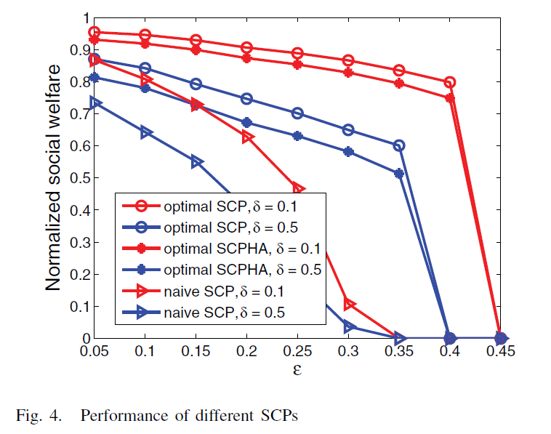
Optimal SCP – Operator assigns a larger working group for a task with a larger load
Optimal SCPHA- Constant number of suppliers.
Naïve SCP- Suppliers reputation is H when it provides resources.
Figure from Yu Zhang,Mihaela van der Schaar, “Incentive Provision and Job Allocation in Social Cloud Systems”

Slide 21
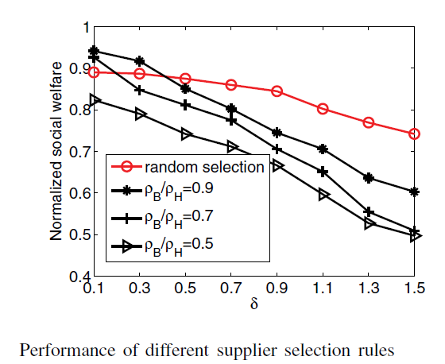
Reputation-based supplier selection rule is as follows: when a supplier has sufficient idle storage space to accept a job, it has a probability ρH to be selected if its reputation is H and has a probability ρB to be selected if its reputation is B.
When suppliers become less patient with δ increasing, reputation-based supplier selection degrade the
system performance.
Figure from Yu Zhang,Mihaela van der Schaar, “Incentive Provision and Job Allocation in Social Cloud Systems”

Slide 22

Conclusion
The paper proposes many design incentive mechanisms and job allocation schemes in social cloud systems which helps to prevent the free-riding behavior of users.

Slide 23

“ A Social Compute Cloud: Allocating and Sharing Infrastructure Resource via Social Networks ”
Published in IEEE Transactions on Services Computing, 28th January 2014
Simon Caton, Member, IEEE,
Christian Haas, Member, IEEE,
Kyle Chard, Member, IEEE,
Kris Bubendorfer, Member, IEEE,
Omer Rana, Member, IEEE,

Slide 24


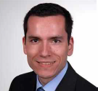


About the Authors!
Simon Caton Kyle Chard
Senior Researcher, Senior Researcher, Karlsruhe Institute of Tech, Germany
Christian Haas
PhD Student,
University of Chicago
Karlsruhe Institute of Tech, Germany
Chris Bubendorfer
Omer F Rana
Program Director for Networking Eng
Victoria University, Wellington
Professor,
Cardiff University, UK

Slide 25

Main idea of the paper
As apps become more sophisticated, it is easier for users to share their own services, resources and data via a Social Network.
Authors present a “Social Compute Cloud” using which resource owners can offer virtualized containers on their personal computers to their social network. They are shared on best effort basis and preference based approach.

Slide 26

What are Infrastructure Resources?
Physical hardware used to interconnect computers and users. Infrastructure includes the transmission media, the routers and other devices that control transmission paths.
Storage devices and the software used to send, receive, and manage the data
Infrastructure resource is viewed as everything that supports the flow and processing of information.

Slide 27

Why share Infrastructure resources via Social Networks?
Users spend 1 in 7 minutes of their Internet time accessing Social Networking sites.
If only 0.5% of FaceBook users provided CPU time on their personal compute resources the potential computational power available would be comparable to a Supercomputer
25 years of CPU Cycle stealing
16 years of volunteer computing since the Great Internet Mersenne Prime Search

Slide 28

Social Compute Cloud
Owners of resources offer virtualized containers on their personal computers or smart devices to their social network.
Resources are offered on a best effort basis.
Resources can be
CPU time
Memory
Disk storage
Providers host sandboxed
light weight Virtual machines
Things considered while allocating
resources
Welfare
Allocation fairness
Algorithmic runtime

Slide 29
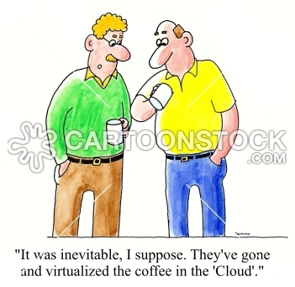
Sharing Infrastructure resources using Social Compute Cloud?
Users download and install middleware
Use their personal social network via a FaceBook application
Provide resources / consume resources from their friends through a Social Clearing House
Bidirectional preference
based resource allocation is
followed.

Slide 30
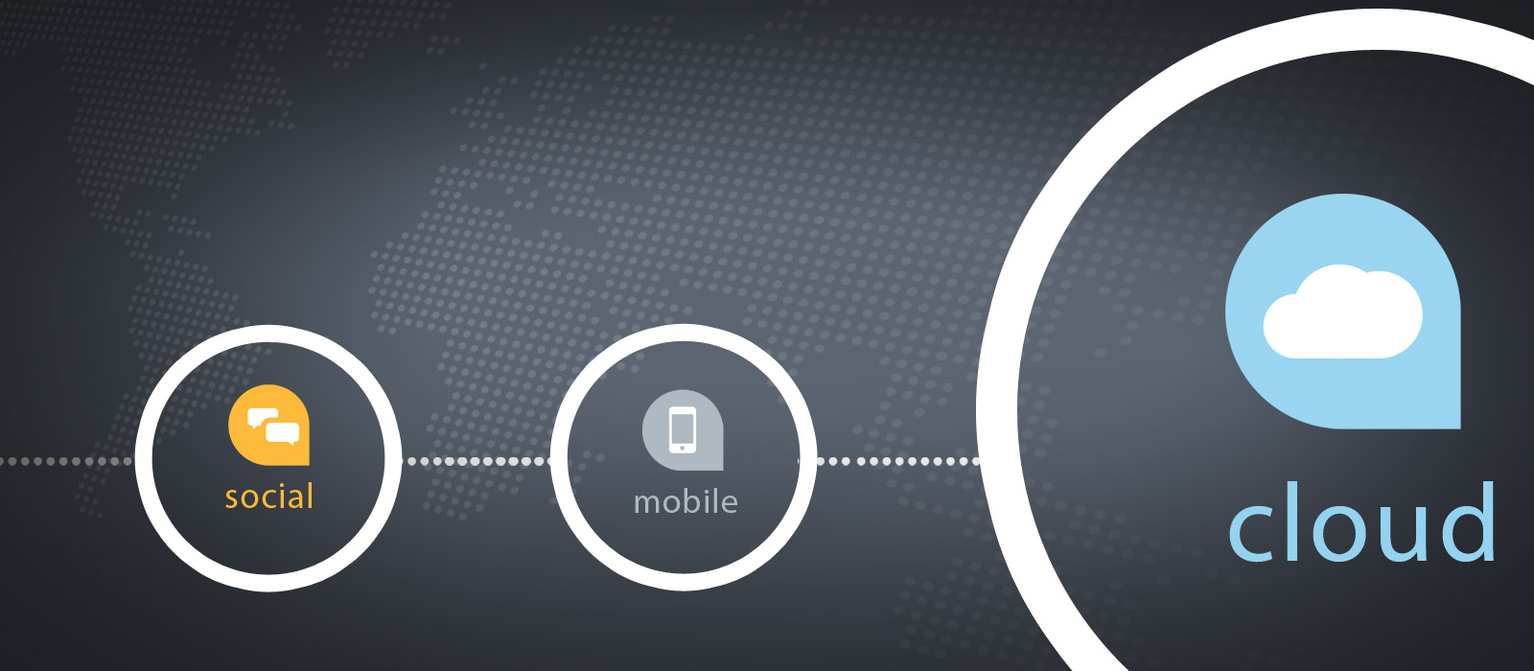
Challenges in the Construction of Social cloud 1: Technical facilitation
Users are spread across the globe. It’s a challenge in itself to provide and consume resources from one another
Traverse NAT
Handle non static IP addresses
Accommodate best effort notions of QoS
Adequate security and Sandboxing mechanisms are required
Need to support multiple operating systems

Slide 31

Challenges in the Construction of Social cloud 2: Leveraging Social Structures
The social structures should be used to maximum advantage
To share resources with any individual, the user must 1st allow access to his social network
Social relationships are complex. Close friends and acquaintances can be a part of your social network : different levels of trust
It’s always better to share compute resources with people in the computer science field because they usually maintain high configuration devices

Slide 32
Challenges in the Construction of Social cloud 2: Leveraging Social Structures
Seeing the above stated examples, additional meta data(“Data about data”) is required to determine with whom a user wants to provide/consume resources
It is a tough task to design methods which can extract the preferences from the user implicitly or explicitly

Slide 33

Challenges in the Construction of Social cloud 3: Platform facilitation
Revenue model cannot be associated with this since its based on social relationships.
The platform requires computational resources to function but the model of Social cloud is based on the fact that the users do not have to pay for the resources they use.
The notion of the revenue model to support the platform and its basic functionalities is problematic

Slide 34
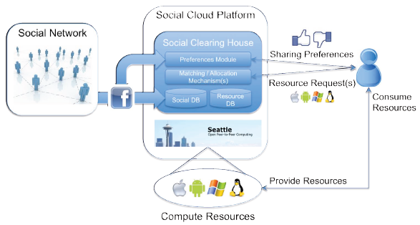
Architecture of Social Compute Cloud
Social Cloud Platform
Social Clearing house : Protocols used for resource allocation
Middleware : Seattle
Socio technical adapter : FaceBook
Socio-economic model
Social Adapters and User preferences

Slide 35
Social Cloud Platform
Social Clearing house: Protocol used for resource allocation and the rules of exchange. There are 2 databases for this
Middleware: Define the protocols for the users to join or leave the system. Eg : Seattle
Socio-technical adapter: Provides access to the user’s social network and acts as a means of authentication.
Preference module: Capture and represent the sharing preferences of a user.
Matching mechanism: Allocate resources based on the sharing preferences
Compute resources: Actual resources to share

Slide 36
Social Adapters and User preferences
Social Adapters
Used to access the user’s social network.
They are not embedded as a part of the social network application.
They are external API’s which will gather the required data
User preferences : Can be derived as follows
Ask users to rank friends : Scaling issue if many friends
Social network analysis to identify preferences : Developing methods and indicators to do this is challenging
Social network interaction theories to construct interaction model : Invasive of users privacy

Slide 37
Socio-Economic Model
Specifies which kind of preference matching is used and how it is implemented to share the resources.
Market design Objectives can be
Finding solutions to the matching problem which are stable
Optimizing welfare of users
Fairness between the 2 parties
Computational time

Slide 38
Implementation of Social Cloud Component 1 : Seattle
Seattle is a open source P2P computing platform
Has a light weight virtualization middleware
It is designed to create distributed overlay network over compute resources donated by users
Core components
Node managers: Verifies user credentials, advertises host machine location
Virtual machines(Vessel) : Sandboxed environments for security and performance isolation
Clearing house: Web based portal which facilitates matching process

Slide 39
Implementation of Social Cloud Component 2: Implementing a Social Clearing House
Social network integration : To access profile information and friend list
Preference assignment : Define preference of a friend as a consumer and provider
Social resource allocation : Best effort random allocation

Slide 40
Implementation of Social Cloud Component 3: Preference based matching
Matching algorithms
Deferred Acceptance algorithm : Best for 2 sided matching.
Advantages : Short runtime and stable solution
Disadvantages: No welfare guarantee, yields unfair solution
Welfare-Optimal algorithm : Yields stable solution with the best welfare score
Approximation algorithm shift
Genetic Algorithm(GA)
Genetic algo with Threshold accepting algo (GATA)
Matching service
RESTful encapsulation of the above algorithms : Batch or Single allocation

Slide 41
Evaluation
Allocation algorithm runtime
Considerations for Stochastic participation
Random
Greedy

Slide 42
IEEE Focus Paper
Scaling Social Media Applications into Geo Distributed Clouds
Authors:
Wu, Chuan Wu, Member, IEEE, ACM,
BoLi, Fellow, IEEE, Linquan Zhang, Zongpeng Li, and
Francis C. M. Lau, Senior Member, IEEE
Manuscript received October 15, 2013; accepted January 29, 2014; approved
by IEEE/ACM TRANSACTIONS ON NETWORKING Editor L. Ying. This work
was supported in part by a Hong Kong RGC grant under Contract HKU717812E, an RGC grant under Contract 615613, an NSFC/RGC grant underContract N_HKUST610/11, an NSFC grant under Contract U1301253, and a
ChinaCache Int. Corp. grant under Contract CCNT12EG01

Slide 43
What will we mainly discuss about
Geo Distributed Clouds.
How geo distributed cloud can help in scaling social media application. Issues.
Geo Dispersed Social Cloud Issues.
System Model Proposed solutions : One Shot Optimization
Performance Evaluation

Slide 44
Geo distributed clouds
Various cloud service providers : EC2, S3, Microsoft Azure, Google App Engine.
Provides services to one or more geo locations.
One service provider can not full fill all demand equally well for all the locations for Geo distributed Cloud.
Different cloud service providers who have data centers in different geo location collaborate together based on certain standards and policies.
This Collaboration provides geo dispersed cloud service platform to truly fulfill the promise of cloud computing.
Social media applications such as Facebook, Youtube, twitter means dynamic demand.

Slide 45
How geo distributed cloud can help in scaling social media application
Geographically distributed cloud can provide services to the user in near proximity.
Users from different location in worlds are interconnected based on some relationship. They can requests the content from all over the globe. Also the user’s behavior is very inconsistent and volatile.
large user base, multimedia contents, millions of requests demands large storage and high bandwidth.
Imposes very strict requirement on response latency in serving and viewing requests. specially for videos.
As most of the videos are short, even a delay of few seconds is intolerable and may annoy the user.

Slide 46
How geo distributed cloud can help in scaling social media application continue….
Geo distributed cloud can provide effective request distribution.
The social network applications can be migrated to geo distributed cloud infrastructure.
Automatic on demand provisioning of servers provides infinite on demand cloud resources.
Much larger capacities for storage and bandwidth to handle large user base and millions of requests. Low latency in streaming videos.
Less management effort and operational costs.

Slide 47
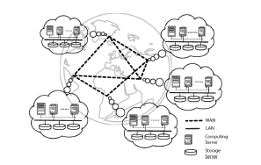
System Model
Fig 1. Geo Distributed cloud model

Slide 48
System Model – Geo distributed Cloud
Consists of multiple disparate cloud sites distributed in different geographical locations.
Owned by one or multiple cloud service providers
Each cloud site contains collection of interconnected and virtualized servers and resides in one data center.
In each data center there are two categories of servers.
Storage servers which stores data files.
Computing servers which support running and provisioning of virtual machines.
Both storage and computing servers are interconnected with high speed switches.
Cloud sites are connected over WAN

Slide 49
Geo distributed Cloud Core Issues
Users are connected globally. A user from India may request the content which was uploaded from user in United States of America.
Number of user and contents and no of users requests are not fixed and dynamic
How to store the social media contents so that it can serve the request in cost effective way which requires migration of contents in between different cloud sites.
Now the question is how to migrate contents across different cloud sites such that operational costs are minimized.
How to design an algorithm which can store the content and also distribute the contents dynamically, and also make the system intelligent with time.

Slide 50
Core Issues continue…..
Users are connected globally. A user from India may request the content which was uploaded from user in United States of America.
How to distribute requests across different sites with different charges and proximities of user to keep the response delays minimal and satisfy the Quality of Service promised by the cloud application provider
A user from India may demand to view a video which is stored in cloud sites in America. The cloud site in America serves the requests, it may cause some propagation delay which is directly proportional to length. The may also be not limited to only one user. In this scenario the best approach is to replicate and migrate the content to some cloud site in India or near India.
Algorithm which provides the complete knowledge of the system over a long time.

Slide 51
Proposed Solution
First Proactive content migration can be enabled by predicting future demands.
Capture propagation of videos based upon:
Social connections and relationships between the users of application. Generally the people are more tend to watch a video which has been watched, shared or commented by their friends.
Interest correlations. For example if a user watched a French Open clip may view an other one from Wimbledon. So probability is high that he will watch the other video related to the video he or she watched.
Correlations among video contents example YouTube. Users are most likely to watch the recommended contents.

Slide 52
Proposed Solution Continue…
Web crawling methodologies can be used to fetch the video view counts, popularity information(likes, dislikes, user comments)
Second one shot optimal content migration and request distribution strategy by formulating the problem as mixed integer program to serve the future demand.
Third, a delta(t) step look-ahead mechanism is proposed to adjust the one-shot optimization results toward the offline optimality, which gives rise to the online algorithm.
Objective is to design an online algorithm to optimally replicate videos onto cloud sites with different charges and proximities to users and dispatch video requests to the sites such that timely responses at the lowest cost are achieved.

Slide 53
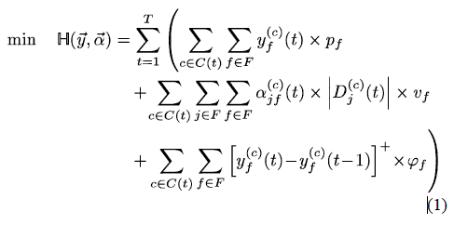
Offline Optimization
First an offline optimization problem can be formulated that gives the “ideal” optimal strategies for content replication and request dispatching, assuming complete information of the system over the entire time span is known.
According to offline optimize solution the cost for cloud site f to serve request from location j over a possible Long time interval can be calculated as VM rental cost + upload bandwidth cost from location f to j + migration cost to move video c
in cloud site f.

Slide 54
Offline Optimization continue….
However the previous formulation is not feasible.
We can not predict a social network system for long time.
User's request varies with time and the relationships he creates.
Instead of using the offline optimization solution for long period of time, we can use it for small interval.
We can use one shot optimization.
Optimization one can be divided into many one shot optimization.
The idea is solve one shot optimization problem in each time-slot and
Adjust the derived solution towards offline optimum using predicted demand in delta t time slot in future.

Slide 55
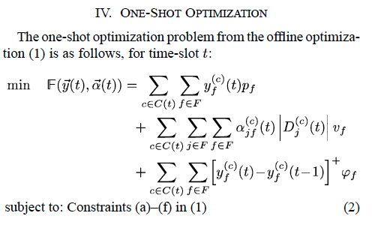
One Shot Optimization
Here in time slot (t-1) predict the upcoming requests from different regions for different videos for time slot t.
And solve the one shot optimization towards offline optimality.

Slide 56
Predicting the number of viewing requests
And solve the one shot optimization towards offline optimality.
Potential users to predict the no of viewing requests can come from following sources.
First Friends who have watched the video and commented on video.
Friends of friends who have not watched the video.
Second the users to whom system has recommended the video.
We can predict the no of possible view requests for video c for next time interval t using following formula:
(No of potential users- no of users who have already watched) + friends of users who commented on video and have not watched it yet)+(users to whom system recommends to watch the video c).
Next the no of potential viewers in a particular region is calculated.

Slide 57
Online Algorithm with delta(t) Step Look Ahead
One shot optimal decision and strategy do not guarantee the optimality of the offline optimization for long period of time.
There can be a decision of removing video based on online optimality for a small time t but letter on the same video can become popular again and not deleting video could have saved migration cost.
According to the offline optimization optimality the content replication strategy and distribution strategy should be computed by tracing back the cost of all the cost incurred till time t-1 and adding the cost incurred at time t.
If the value of one shot optimal decision = 1, Caching of video c should be done to reduce long time cost.
In offline optimum if video c is needed in future, it is desirable to store c in the site.
Even if the video c is not needed in near future, video c should be cached.

Slide 58
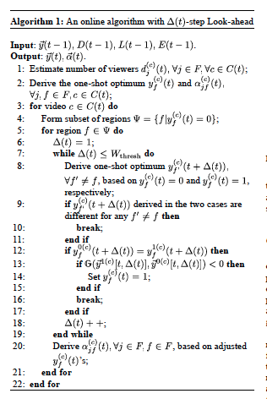
Online Algorithm with delta(t) Step Look Ahead

Slide 59
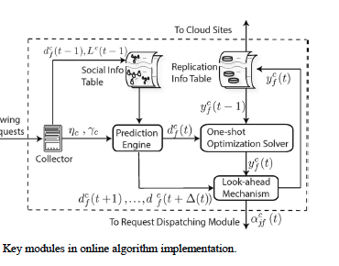
Key Modules in Online Algorithm Implementation

Slide 60
Implementation in a real World system
How demand prediction and one shot optimization can be implemented.
In social media application , the algorithm can be deployed on tracker server which is responsible in receiving user’s request and sending them to cloud site.
The collector collects no of request for each time interval t
All the friend relationship and video recommendation information is stored in social information table.
The summarized statistics are fed into Prediction engine which estimates the no of requests in next time slot t
Based on demand prediction and current video replication status from replica information table the one shot optimization solver solves the one shot optimization.
The look ahead mechanism use the above to solve offline optimality.

Slide 61
Implementation in a real World system cont..
The resulting content replication predictions are sent to the cloud sites.
Based on this decision the videos and VMs are pre deployed in case of increased demands.
The videos with less demands can be deleted.
Request distribution statistics are used to distribute upcoming requests to appropriate cloud site.
Issues
The algorithm can run in interval of few hours
Newly uploaded video is always stored to the closest site near the uploader.

Slide 62
Prototype Implementation and experimental settings
Geo distributed cloud was created by emulating cloud site using Amazon. In different regions of world
The round trip delay between each pair of cloud site are the real life measured values.
On each cloud site different charges were applied.
In each region group of users were simulated using extra micro instance which produces the viewing requests
The roundtrip between the user and cloud site was also set to 20 ms if in the same region otherwise 150 ms .
One more extra large instance created as Tracker server.
Each time slot taken as 1 hour long.
User relation ship matrix specified to define how users are connected to each other

Slide 63
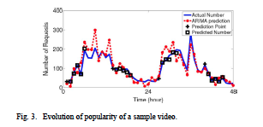
Performance Evaluation Against ARIMA
ARIMA is widely used mode for non stationary time series predictions.
In this figure the solid curve plots the actual viewing request in a time span of 48 hours. Dotted curve corresponds to ARIMA prediction.
t\The black square represents prediction results using the epidemic model discussed in the paper.

Slide 64
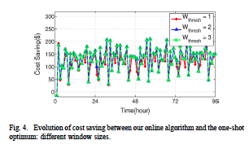
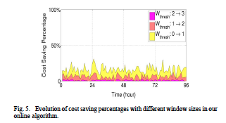
Performance Evaluation Against ARIMA Cont. ..

Slide 65
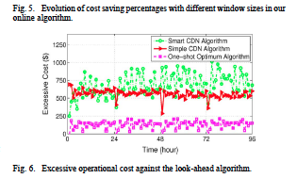
Performance Evaluation Cont..
The performance evaluation results show that predicted number using the proposed model follow the actual number quiet well.
However the ARIMA models fail to capture the social influence among users and performs poorly.

Slide 66
Conclusion
The paper proposes a proactive online algorithm to scale social media application in geo dispersed cloud.
An effective epidemic model was build by exploiting the social influences among users.
An optimal content migration and optimal request distribution strategy was formulated by aiming at minimizing the operational cost.
Both long time and one shot optimization formulation are given
A delta t step look ahead mechanism was designed with guarantees to adjust the one shot optimum towards offline optimality
The emulation of proposed solution under realistic setting confirms the excellent performance.

Slide 67

Final Conclusion
We have analyzed different issues in Social cloud but there are some motivations for developing applications for Social Cloud
Access to huge User Communities
Volunteer Computing unsatisfactory
Barter Model of resource sharing on the cloud
Tapping the inherent trust relationships in Social Networks

Slide 68
References
Yu Zhang, Mihaela van der Schaar: “Incentive Provision and Job Allocation in Social Cloud Systems”.
Simon Caton, Christian Haas, Kyle Chard, Kris Bubendorfer, Omer Rana “ A Social Compute Cloud: Allocating and Sharing Infrastructure Resource via Social Networks ”.
Yu Wu, Chuan Wu, BoLi, Linquan Zhang, Zongpeng Li, and Francis C. M. Lau: “Scaling Social Media applications into Geo Distributed Clouds”, IEEE/ACM TRANSACTIONS ON NETWORKING.
Gayathri K S, Tony Thomas, J Jayasudha: “Security Issues of Media Sharing in Social Cloud”, International Conference on Modelling, Optimization and Computing 2012.

Slide 69
Thank you !!

